Slide 1
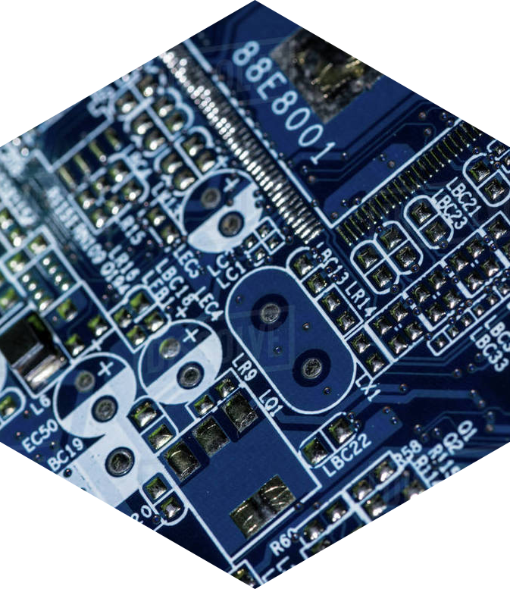
GROUP 7
Thesis
Student Name | ID
Ahamed Fardit | 18-36119-1
Islam Shafiqul | 17-35504-3
Mahdi Ahmed Tahsin | 18-39255-3
Naeem Sultan | 18-37270-1
PRESENTATION

Slide 2
Mango Leaf disease Detection
Thesis
PRESENTATION
Using CNN Image Processing

Slide 3
Overview
Problem Statement
Proposed Idea
Existing Works
Results
Proposal
Methodology
Future Work

Slide 4
Problem Statement
Pests and diseases are responsible for 30-40% of the losses in agricultural production. A slew of diseases plagues the mango crop.

Slide 5
Problem Statement Cont….

Slide 6
Proposed Idea

Slide 7
Existing works
 | Authours | Model used
Recognition of mango leaf disease using convolutional neural network models: a transfer learning approach | SAditya Rajbongshi Thaharim Khan Md. Mahbubur Rahman Anik Pramanik Shah Md Tanvir Siddiquee Narayan Ranjan Chakraborty | DenseNet201 InceptionV3 ResNet50 ResNet152V2 Xception InceptionResNetV2
Mango Leaf Diseases Identification Using Convolutional Neural Network | S. Arivazhagan S.Vineth Ligi | VGG-16 VGG-19 Alexnet
Deep Learning for Image Based Mango Leaf Disease Detection | Sampada Gulavnai Rajashri Patil | ResNet 18 ResNet 34 ResNet51
Multilayer Convolution Neural Network for the Classification of Mango Leaves Infected by Anthracnose Disease | UDAY PRATAP SINGH SIDDHARTH SINGH CHOUHAN SUKIRTY JAIN | MCNN

Slide 8
Proposal

Slide 9
Methodology
01
Research
Analysis
03
It’s the ringed one and a gas giant composed
of hydrogen and helium
Venus has a beautiful name and is the second planet from the Sun
02
Data Study
Comparison
04
Mars is full of iron oxide dust, which gives the planet its reddish cast
Mercury is the closest planet to the Sun and the smallest one

Slide 10
Dataset

Slide 11
Results

Slide 12
Results Cont…

Slide 13
Future Work

Slide 14
Future Work Cont….

Slide 15
Thank You
PROJECT
PRESENTATION

